Slide 1
Inverse problems project
Today:
Possible metrics for comparison.

Slide 2
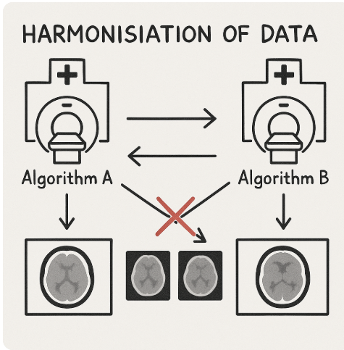

Problem overview
🏥 Understand differences in CT image reconstruction: Compare how different reconstruction algorithms (e.g. iDose vs IMR vs FBP) affect the final medical images from the same sinogram data. Investigate the effect of noise on both methods.
🔁 Investigate harmonisation: Develop methods to harmonise images reconstructed by different algorithms so that they can be meaningfully shared and interpreted across hospitals.
🔎 Investigate transformation: Explore whether images from one reconstruction method (e.g. iDose) can be transformed to resemble another (e.g. IMR).

Slide 3
Sinogram -> image
Filter Back projection (FBP) → not stable because of noise.
Iterative method:
iDose & IMR
min_ x L(x) = min _ x 1/2 || Ax –y || ^2 + R(x)
d L(x)/ dx = A^(*T) (A x – y) + R’(x)
A: radon transfrom
x: sinogram
y: sinogram
Q: Is A^*t gelijk aan iradon zonder filter?

Slide 4
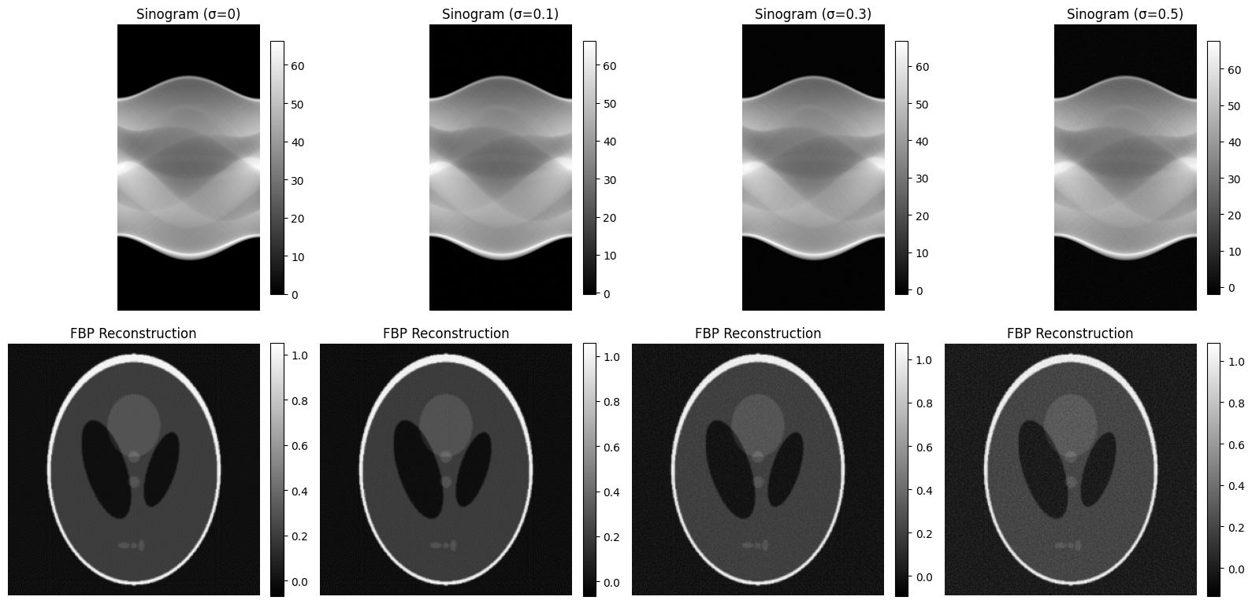
Initial results using FBP
FBP:
# theta = 180
Filter: ‘ramp’

Slide 5
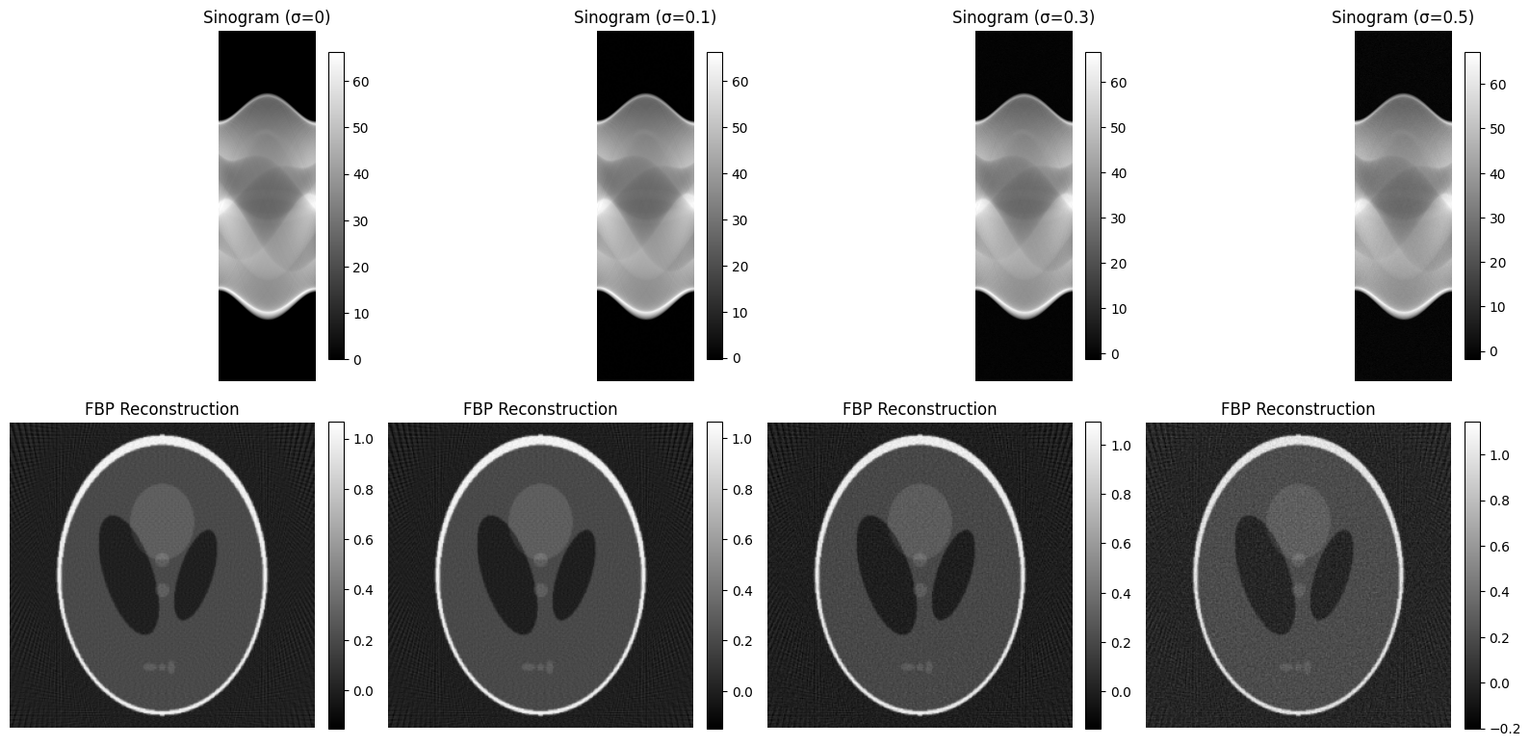
Initial results using FBP
FBP:
# theta = 100
Filter: ‘ramp’
Less theta → noise hits
harder.

Slide 6
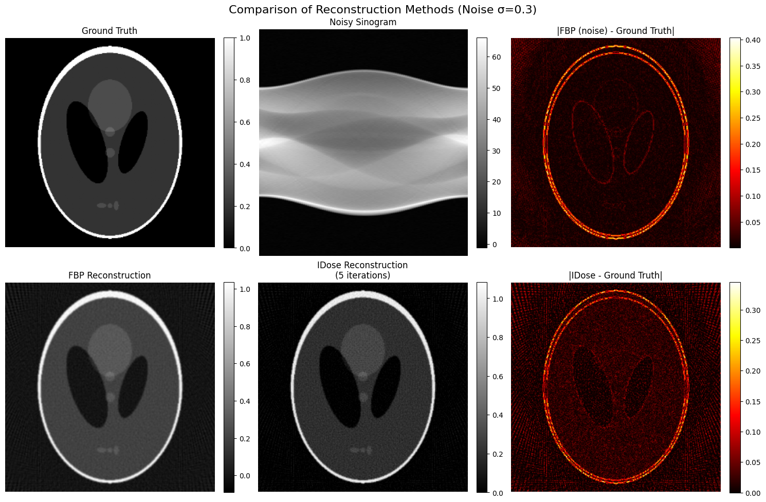
Initial via iterative method
FBP:
# theta = 100
Filter: ‘ramp’
It = 5
No regulariser

Slide 7
Initial with regularisor
FBP:
# theta = 100
Filter: ‘ramp’
It = 5
No regulariser
I tried Cauchy prior, TV with a proxy but it doesnot make it much better

Slide 8
Vragen
In IMR the A has physical prior information it is now hard to implement this in our model.
What is the expect noise? It would be log of poision noise right?
There is also a W? what is this thing?
Possible metrics for comparison.

